Slide 1




Introduction and Background
Sr. Software Engineer
Full-Stack
Microsoft .NET, T-SQL, Azure, Azure DevOps
WGU Master’s in Data Analytics Graduate Student
Jupyter Notebook
Python
Markdown
André Davis

Slide 2




Problem and Hypothesis
Problem:
SPAM can lead to -
Viruses
Phishing
Ransomware
A computer virus is a type of malicious software that replicates itself by modifying other computer programs, potentially damaging system functionality, corrupting files, or stealing data.
Phishing is a fraudulent attempt to obtain sensitive information by disguising as a trustworthy entity in digital communication, often using email to trick recipients into revealing personal data like passwords and credit card numbers.
Ransomware is a type of malware that encrypts a victim's files and demands payment to restore access. It often spreads through phishing emails or security vulnerabilities, causing data loss and financial damage.
Hypothesis:
A machine learning model can be created that accurately identifies SPAM greater than 95%.

Slide 3

Summary of Data-Analysis Process
Data Collection
Kaggle – Enron Emails (Labeled [SPAM or HAM])
Data Extraction and Preparation
Loading Data
Missing Data Check
Label Balance Verification
Text Data Pre-Processing
Pre-Processing for Machine Learning
Text Normalization
Punctuation Removal
Tokenization
Top Word Removal
Vectorization (Embeddings)
Logistical Regression

Slide 4

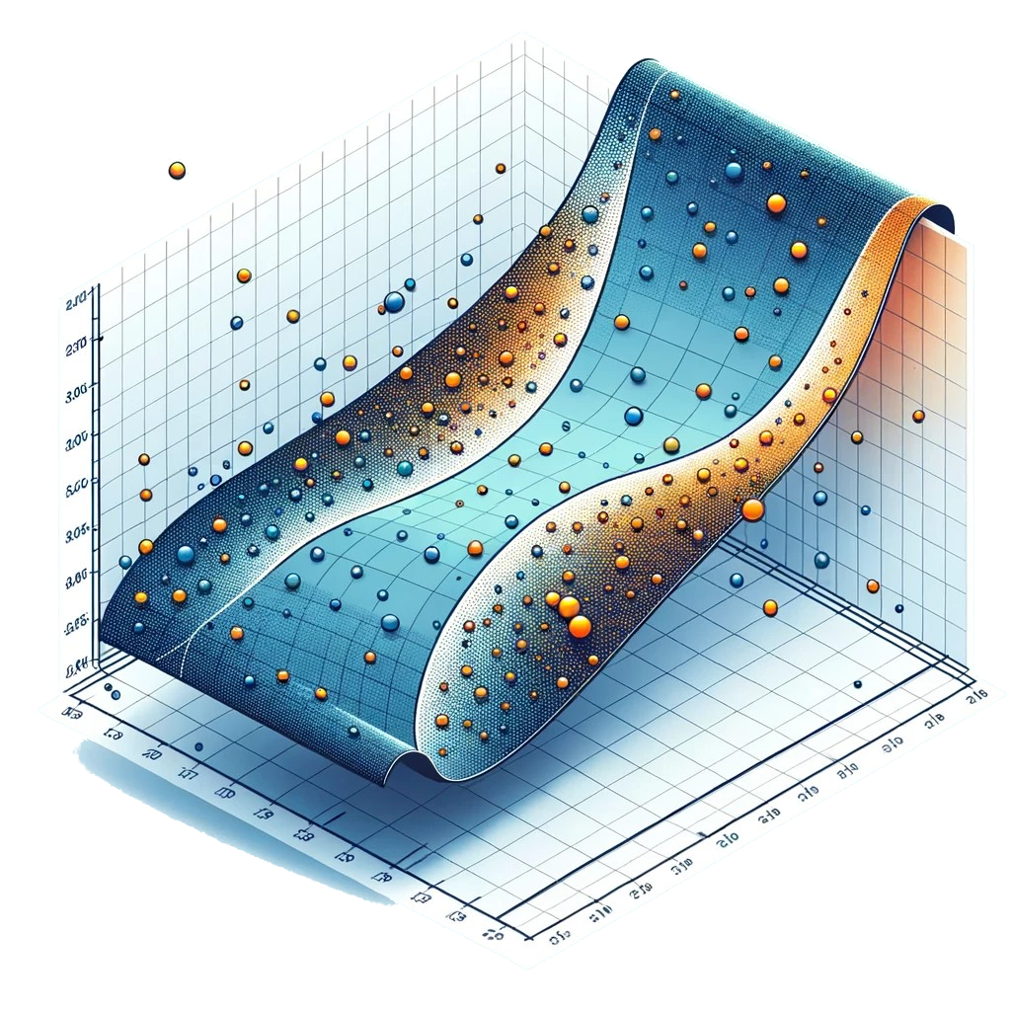
Outline of Findings
The Machine Learning Model (Logistical Regression) Results:
99 times out of 100 correctly identified email as SPAM or HAM (99% Accuracy Score)
98.2 out of 100 there weren’t any falsely marked emails.
Falsely marked, means emails that are not SPAM but got marked as such.

Slide 5

Limitations of Techniques/Tools
Techniques/Tools Limitations:
Polars although better than Pandas for larger datasets has a smaller community and requires a little extra code to work with libraries that have Pandas in mind.
Sensitive to imbalanced data
The dataset was so large that interpreting the Coefficients wasn’t doable as it required 200MB of RAM to calculated.
Dataset Limitation:
The model’s training is based on data from 2007, which may not fully represent the evolving nature of SPAM. SPAM tactics and content have likely evolved since then, which could affect the model’s effectiveness against current SPAM.

Slide 6

Proposed Actions
Deployment:
Given the high accuracy and effectiveness of this Logistical Regression Model trained on labeled SPAM(1)/HAM(0) emails, it is recommended to deploy this model in a controlled environment. This will allow for further evaluations of its performance with current email data. This would involve monitoring its classification accuracy in real-time and adjusting thresholds or indicate if we need to gather more data to improve the model.

Slide 7
Proposed Actions
Model Updating and Fine-Tuning:
To address the dataset limitation of being an older from 2007 dataset, future studies could focus on continuously updating the model with newer SPAM(1) and HAM(0) datasets. This would help the model adapt to the evolving nature of SPAM and maintain its high accuracy over time.

Slide 8
Proposed Actions
Algorithm Comparison:
Exploring and comparing other machine learning algorithms or deep learning models such as Neural Networks for example, might yield even better results or efficiency. Studies could focus on comparing different models to understand which ones are most effective for SPAM(1) detection in various contexts, including different languages, email formats, and evolving SPAM(1) tactics.

Slide 9

Benefits of Study
Quantitative Outcomes:
Demonstrates exceptional accuracy rate of approximately 98.96%
Immediate usability and strategic roadmap for future improvements
Spam Detection:
Highly reliable logistic regression model
Crucial for mitigating security risks associated with spam emails
Dataset Robustness:
Balanced dataset (47.38% HAM, 52.62% SPAM)
Ensures minimal bias in spam identification

Slide 10
Benefits of Study
Future Strategy:
Continuous updates with modern spam datasets
Exploration of advanced machine learning models like neural networks
Ongoing Improvement:
Capitalizing on current model's strengths
Adapting to the evolving landscape of email threats

